Slide 1

Product Review
Group 3 – Andrew Morcos, Yodit Ayalew, Valerie Jones, Andrew Rush
Notes:
ADR

Slide 2
“Information is the oil of the 21st century, and analytics is the combustion engine.”
Peter Sondergaard (Gartner Research)
Notes:
ADR

Slide 3
Agenda:
Team Goals
Star Schema / Assumptions
High Level Design / Detailed Design
ETL – Significant Challenges
Our Data Story
Recommendations
Questions
Notes:
ADR

Slide 4
Overview
The Fudgemart company elected to merge with Fudgeflix to have a data warehouse created to track sales, order fulfilment and customer reviews.
The Fudge company has set a goal to improve brand image and product appeal through analysis of customer reviews from Fudgeflix and Fudgemart
Notes:
ADR

Slide 5
Team goals
Analyze business processes of Fudgeflix and Fudgemart to capitalize on synergies of the combined company.
Perform a deep dive into product reviews of the merged company.
Present regional and detailed analysis of Fudgeflix and Fudgemart product reviews.
Notes:
ADR

Slide 6
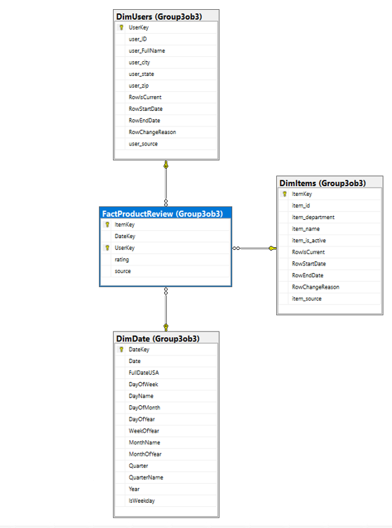
Business Process | Star Schema
Improve Fudge Company brand image and product appeal through analysis of customer reviews from Fudgeflix and Fudgemart.
Notes:
ADR

Slide 7
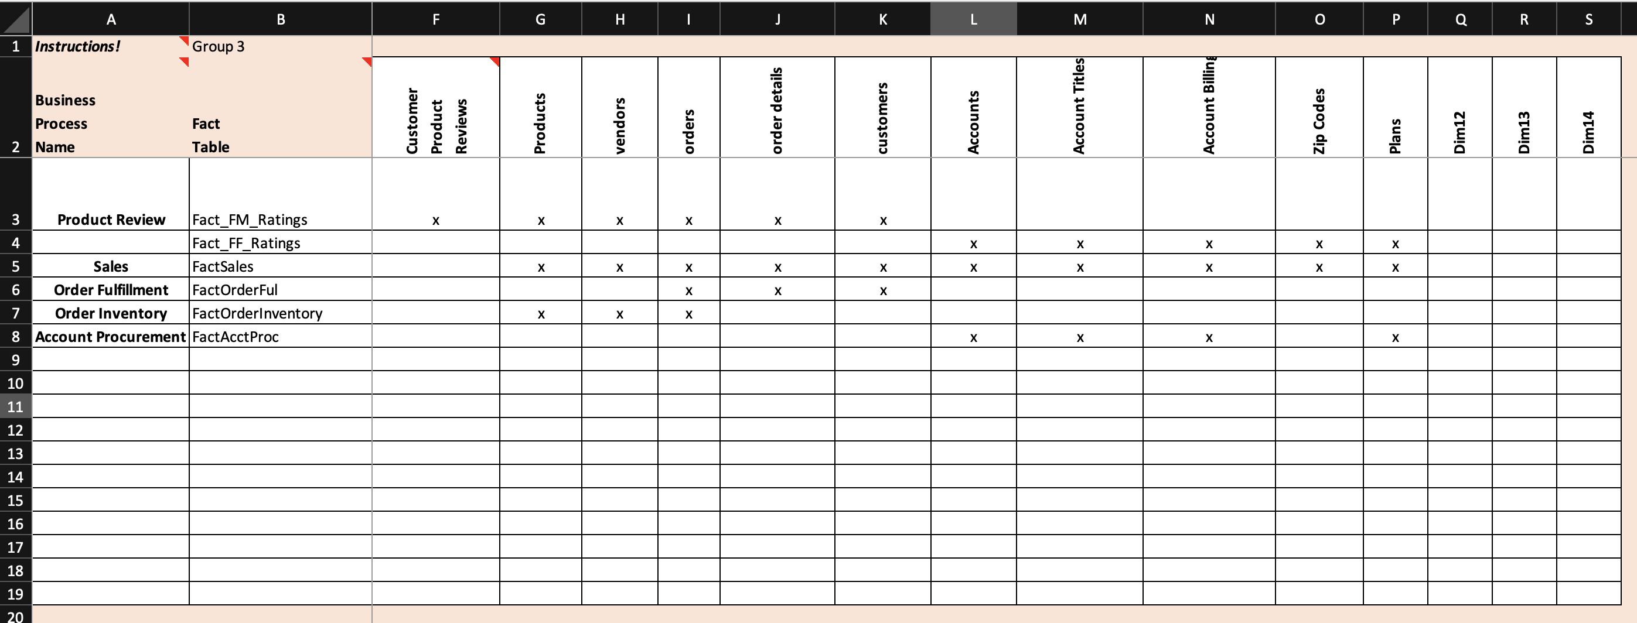
High Level Design

Slide 8
Detailed Design
Dimensions:
DimItem: Product / Title
DimDate: Date Reference
DimUsers: Customers / Account
Fact Table:
Ratings (Measure)

Slide 9
ETL
Design an integrated data warehouse that is usable with both Fudgemart and Fudgeflix data
Fudgemart
ETL
Staging
Product Review
DW
ETL
Fudgeflix
ETL
ETL

Slide 10
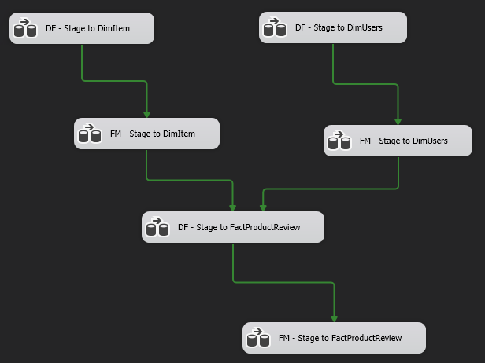
ETL
Control Flow

Slide 11
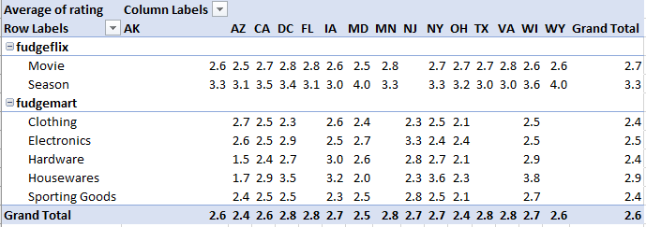
Pivot Table – Company

Slide 12
Merge Data Assumptions
Fudgeflix Account data and Fudgemart Customer data follow the same business rules (EX.Ratings 0 to 5)
Fudgeflix Account title data and Fudgemart Customer product review data follow the same business rules (EX. Presented with the same review questions)

Slide 13
Significant Challenges
Conceptual & Logical Models
SQL would not generate Fact table
SQL generated code Issues
Inconsistent data types
Translating attributes between Fudgemart & Fudgeflix.
ETL Process
Truncation of item_name and item_id; Size mismatch.
Visual Studio nuisances
Derived Column data types and expression building
Slowly changing dimension Config Issues

Slide 14
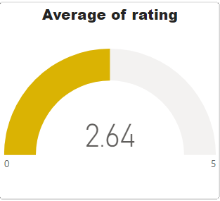
BI Data Story Overall Product Review

Slide 15
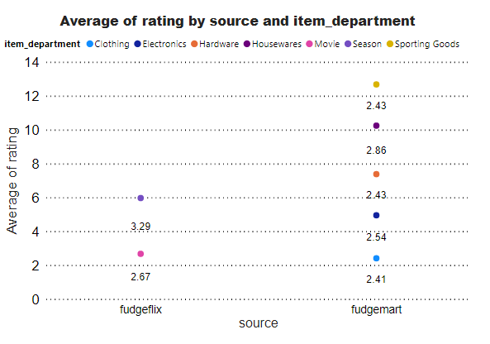
BI Data Story Company Overview
Side-by-side comparison of the individual product reviews of both Fudgeflix and Fudgemart.

Slide 16
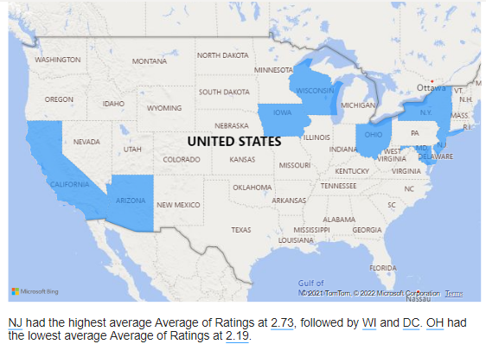
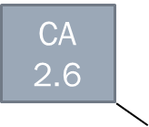
BI Data Story Overall Regional Product Satisfaction

Slide 17
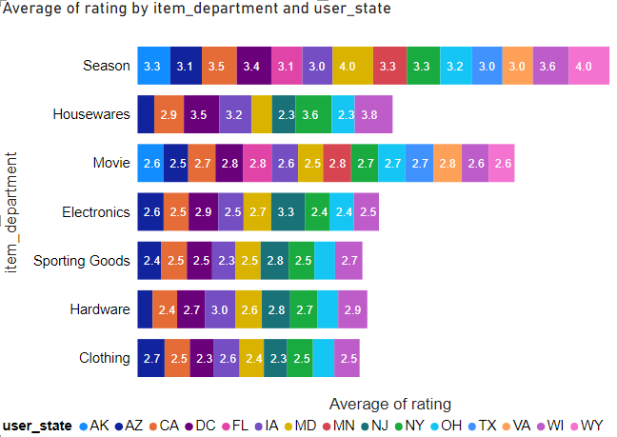
BI Data Story Product Satisfaction
Illustrates average product rating by department and state.
Fudge Co can target improvement campaigns in low rated areas from this analysis.

Slide 18
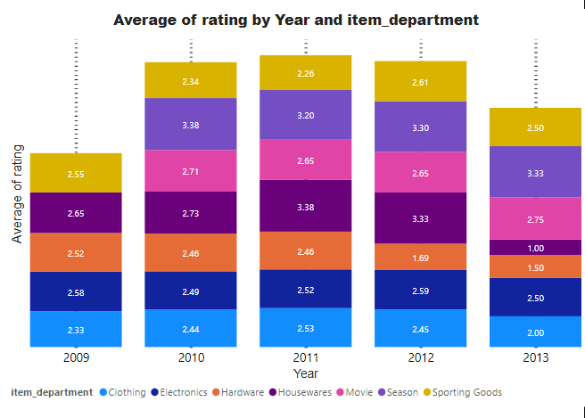
BI Data Story Product Review Trend over Time

Slide 19
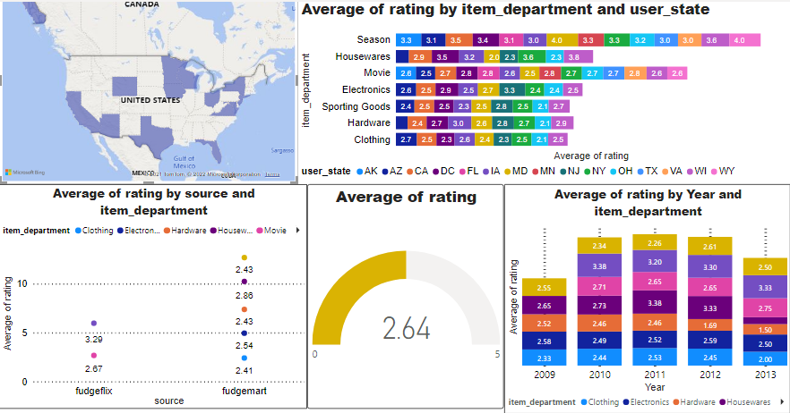
BI Data Story Product Review Dashboard

Slide 20
Recommendations
Fudge Co should investigate the hardware department and figure out why it is having low ratings.
Fudge Co should target WI, OH, and DC with product improvement campaigns to increase customer satisfaction.
Include customer comment attributes and survey data to refine analysis on customer satisfaction.

Slide 21
Questions?

